Slide 1
Modeling Dialogues in Grounded Document
Anuja Tayal
cs521

Slide 2


Motivation
Do models have to know everything??
Feed more data??
Jeopardy - Just know Trivia Question? Facts? Or Smart?
Solution - Grounded Document!!

Slide 3
Dataset
MultiDoc2Dial Dataset Shared Task
4 domains- ssa, student aid, va, dmv
Used dmv subset
Each dialog turn is annotated with role, dialogue act, human-generated utterance and the grounding span with document information
user questions, agent follow-up questions and responding turns
documents | 149
dialogues | 1328
2 Segments | 781
> 2 Segments | 257
single | 290

Slide 4

Dataset

Slide 5
Proposed Solution
3 components
Dialog Act Prediction
Retrieve Model- to retrieve the most important context, given the query
Question Answering Module - given the context and the query, find the answer span

Slide 6
Dialog History

Slide 7
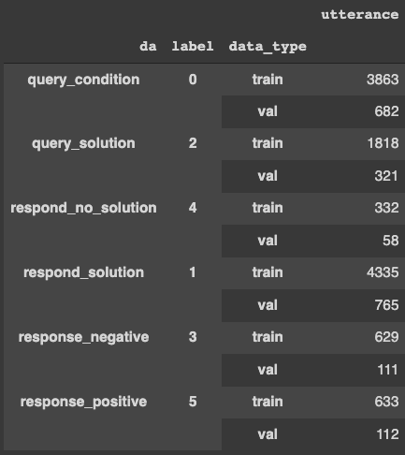
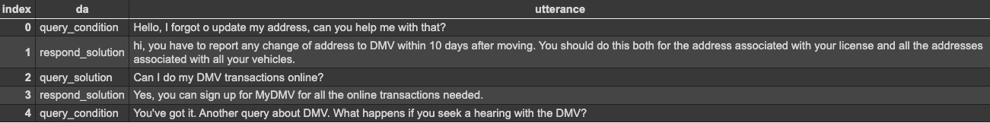
Dialogue Act- Multi Class Classification

Slide 8
Dialogue Act
Train Bert Sequence Classification Model
Batch_size 4
epochs=4
learning_rate=1e-5
Trained through Pytorch transformers

Slide 9
Retrieval Model
Retrieve the most important context given the query
Symmetric Semantic Search- query and context are of same length
Asymmetric Semantic Search- context is huge as compared to query
Dot product- retrieval of long documents
Cosine Product- retrieval of short documents
Msmarco-distilbert-base-dot-prod-v3 model- Sentence Bert Model
Used Sentence Transformer Library and FAISS Library

Slide 10
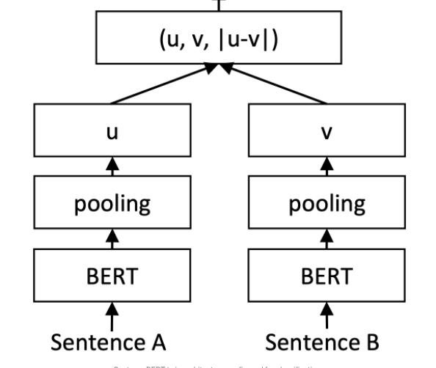
Related Work
TF-IDF
BM-25
SBert
Dense Passage Retrievals (DPR)

Slide 11
Retrieval Model
FAISS: (Facebook AI Similarity Search) is a library that allows to quickly search for embeddings of multimedia documents that are similar to each other.
Used SBERT to embed contexts
Indexed the embeddings through FAISS
For finding the context for given query ,
Encode query through sbert
Search the embedding with indexed db and retrieve top_k results

Slide 12
Retrieval Model
127 unique contexts
6135 query and context values
True | 2788
False | 3347
Accuracy | 50%
True | 4200
False | 1935
Accuracy | 70%
Without history
With history

Slide 13
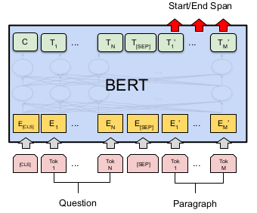
Question Answer Module
BertForQuestionAnswering
epochs=3
Learning rate=5e-5
Batch size=4
Evaluation metric=Bleu Score
Bilingual Evaluation Understudy
score for comparing a candidate translation of text to one or more reference translations.
Average Bleu score = .58

Slide 14
Challenges
Future Work
Context length 5000
Bert max length 512
Use LongFormer to break context
Use chained indexing
Break context into more smaller blocks
Add personalisations

Slide 15
References
MultiDoc2Dial
Doc2Dial
Bert For Question Answering
Faiss
Bleu
SBert
MultiClass Classification

Slide 16
Thank You!!
Questions??

